Slide 1

Dr. T. THIMMAIAH INSTITUTE OF TECHNOLOGY
Oorgaum, Kolar Gold Fields 563120
Accredited by NBA and NAAC with 'A' Grade
Department of Computer Science & Engineering
(Artificial Intelligence & Machine Learning)
PROJECT TITLE – "AI-BASED DEEPFAKE DETECTION USING IRIS RECOGNITION"
Under the Guidance of
Prof. NAVEEN KUMAR V
Dept. of CSE(AI&ML)
Dr . TTIT, KGF
Presented By
SONJUN MURTHY 1GV22CI023
VIVANDER V 1GV23CI403
SANDEEP A 1GV23CI402
RAHUL J 1GV23CI401

Slide 2
AI-BASED DEEPFAKE DETECTION USING IRIS RECOGNITION
INTRODUCTION
Deepfakes pose serious threats to digital media integrity and biometric security.
They can manipulate facial videos and images with high realism, making detection difficult.
This project aims to build an AI system using iris recognition and Vision Transformers (ViTs) for effective deepfake detection.
The solution is optimized for real-time performance on mobile platforms using Flutter.
Dept. of CSE (AI&ML), Dr. TTIT, KGF
Notes:
Image source: https://www.slidemake.com/presentation/Iot-gas-detector-652f644f51c2d9c2ea9f6693

Slide 3
AI-BASED DEEPFAKE DETECTION USING IRIS RECOGNITION
PROBLEM DEFINITION
Deepfake media can be used for misinformation, fraud, and identity manipulation.
Current detection methods lack accuracy and mobile compatibility.
There is a need for a robust model that detects deepfakes in real-time using unique biometric features like the iris.
Challenges in Real-Time Detection on mobile platforms.
Dept. of CSE (AI&ML), Dr. TTIT, KGF

Slide 4
AI-BASED DEEPFAKE DETECTION USING IRIS RECOGNITION
MOTIVATION FOR SELECTION
Growing misuse of deepfakes in social, political, and personal contexts.
Limitations of traditional detection methods.
Potential of AI and deep learning to provide real-time, accurate solutions.
Biometric security through iris analysis offers enhanced precision.
Dept. of CSE (AI&ML), Dr. TTIT, KGF

Slide 5
LITERATURE REVIEW

Slide 6
Lip-Sync Deepfake Detection from Audio-Video Mismatch
AI-BASED DEEPFAKE DETECTION USING IRIS RECOGNITION
Authors: Matyas Bohacek, Hany Farid, Berkeley
The introduction discusses the rise of lip-sync deepfakes, where AI technology is used to manipulate videos so that a person appears to say things they never actually said. These deepfakes have been misused for scams, fraud, and misinformation, as seen in fake endorsements from celebrities like Tom Hanks and Elon Musk.
Challenges Faced:
High initial cost
Potential for bias
Not optimized for Mobiles
Privacy concerns
Dept. of CSE (AI&ML), Dr. TTIT, KGF

Slide 7
AI-BASED DEEPFAKE DETECTION USING IRIS RECOGNITION
Deepfakes Detection by Iris Analysis
Authors: ELISABETH TCHAPTCHET, ELIE FUTE TAGNE, JAIME ACOSTA and DANDA B. RAWAT
The paper introduces a novel deepfake detection method using iris analysis, focusing on the natural characteristics of the human iris, such as shape and light reflections, to identify inconsistencies in GAN-generated images. Experimental results demonstrate the proposed method’s high accuracy and effectiveness
Challenges Faced:
High initial cost
Iris recognition is still being a lack
Not optimized for Mobiles
Lack of real world testing
Dept. of CSE (AI&ML), Dr. TTIT, KGF

Slide 8
AI-BASED DEEPFAKE DETECTION USING IRIS RECOGNITION
Deepfake Detection Based on Visual Lip-sync Match and Blink Rate
Authors: Abdullah Ali Alshehri, Tyler Daws, and Soundararajan Ezekiel
The goal is to develop a user-friendly platform that enables non-experts to upload videos for deepfake detection. By combining two advanced models visual lip-sync matching and blink rate analysis into a single, accessible interface, the platform aims to enhance detection accuracy.
Challenges Faced:
Implementation cost
Integration challenges
Not optimized for Mobiles
Data storage concerns
Dept. of CSE (AI&ML), Dr. TTIT, KGF

Slide 9
AI-BASED DEEPFAKE DETECTION USING IRIS RECOGNITION
Deep convolutional neural networks for face and iris presentation attack detection
Authors: Yomna Safaa El-Din, Mohamed N. Moustafa and Hani Mahd
This paper surveys recent PAD approaches, including active and passive methods, and evaluates the effectiveness of CNNs in face and iris spoof detection. It compares different fine-tuning strategies on multiple benchmark datasets and explores the feasibility of a single CNN model trained for both face and iris PAD.
Challenges Faced:
High initial cost
Potential for bias
Not optimized for Mobiles
Privacy concerns
Dept. of CSE (AI&ML), Dr. TTIT, KGF

Slide 10
AI-BASED DEEPFAKE DETECTION USING IRIS RECOGNITION
Deepfake Detection Using Advanced Machine Learning and Fusion Methods
Authors: Gourav Gupta, Kiran Raja, Manish Gupta, Tony Jan, Scott Thompson Whiteside and Mukesh Prasad
This paper proposes a novel deepfake detection approach based on analyzing eye iris characteristics, using a gradient map technique to identify unique iris properties such as shape, size, and light reflection. The proposed method achieves high accuracy and sensitivity in detecting GAN-generated images, demonstrating its effectiveness in identifying falsified content
Challenges Faced:
High initial cost
Limited scope
Not optimized for Mobiles
Lack of real world testing
Dept. of CSE (AI&ML), Dr. TTIT, KGF

Slide 11
AI-BASED DEEPFAKE DETECTION USING IRIS RECOGNITION
BASE PAPER: Deepfakes Detection by Iris Analysis
Authors: ELISABETH TCHAPTCHET, ELIE FUTE TAGNE, JAIME ACOSTA and DANDA B. RAWAT
The paper introduces a novel deepfake detection method using iris analysis, focusing on the natural characteristics of the human iris, such as shape and light reflections, to identify inconsistencies in GAN-generated images. Experimental results demonstrate the proposed method’s high accuracy and effectiveness
Challenges Faced:
High initial cost
Iris recognition is still being a lack
Not optimized for Mobiles
Lack of real world testing
Dept. of CSE (AI&ML), Dr. TTIT, KGF

Slide 12
AI-BASED DEEPFAKE DETECTION USING IRIS RECOGNITION
ABSTRACT
This project develops an AI-powered system that detects deepfakes using iris recognition.
It integrates Vision Transformers for detailed feature extraction and analysis.
Optimized for mobile implementation using Flutter.
Goal: deliver a scalable and accurate deepfake detection framework.
Dept. of CSE (AI&ML), Dr. TTIT, KGF
Notes:
Image source: https://www.britannica.com/science/ideal-gas-law

Slide 13
AI-BASED DEEPFAKE DETECTION USING IRIS RECOGNITION
OBJECTIVE
Detect deepfakes in images and videos using AI.
Leverage iris-based biometric features for improved detection.
Utilize Vision Transformers for advanced static image analysis.
Integrate the model into a real-time mobile application.
Dept. of CSE (AI&ML), Dr. TTIT, KGF

Slide 14
AI-BASED DEEPFAKE DETECTION USING IRIS RECOGNITION
HARDWARE AND SOFTWARE REQUIREMENTS:
HARDWARE:
Processor: Intel i5/i7 or equivalent
RAM: Minimum 8GB
Storage: 256GB SSD or more
GPU: NVIDIA GTX 1650 or higher
SOFTWARE:
OS: Windows/macOS/Linux
Programming Language: Python 3.8+
IDE: VS Code / Jupyter / Android Studio (for Flutter)
Libraries: OpenCV, TensorFlow/PyTorch, scikit-learn, Transformers
Framework: Flutter for app development
Dept. of CSE (AI&ML), Dr. TTIT, KGF

Slide 15
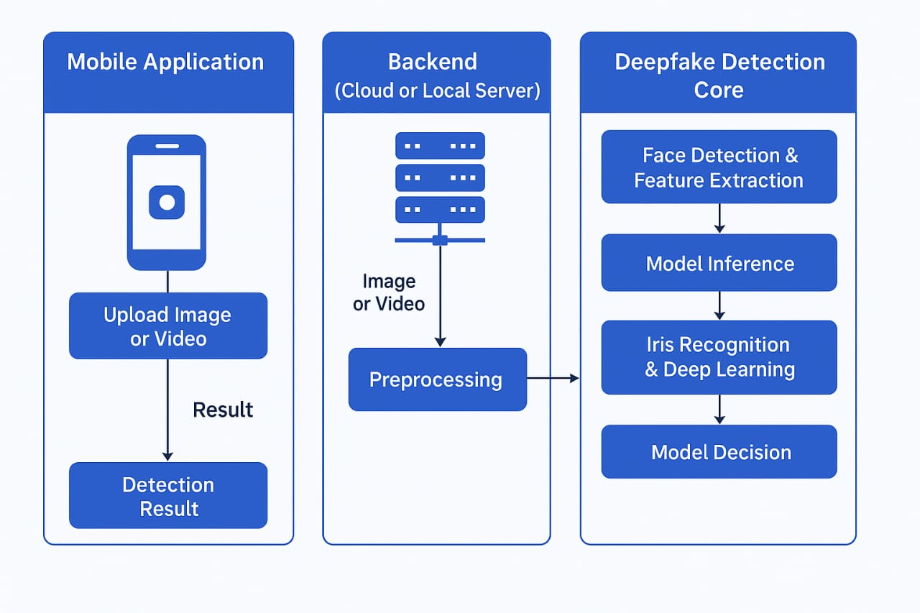
AI-BASED DEEPFAKE DETECTION USING IRIS RECOGNITION
SYSTEM ARCHITECTURE
Dept. of CSE (AI&ML), Dr. TTIT, KGF
Notes:
Image source: https://wiringmanualvernations.z19.web.core.windows.net/functional-block-diagram-of-cpu.html

Slide 16
AI-BASED DEEPFAKE DETECTION USING IRIS RECOGNITION
METHODOLOGY
Step 1: Collect deepfake datasets (e.g., FaceForensics++)
Step 2: Preprocess data, extract iris regions, normalize images.
Step 3: Train ViT model on static iris frames.
Step 4: Evaluate model using metrics like precision, recall, F1-score.
Step 5: Export model and integrate into Flutter app for real-time detection.
Dept. of CSE (AI&ML), Dr. TTIT, KGF

Slide 17
AI-BASED DEEPFAKE DETECTION USING IRIS RECOGNITION
ALGORITHM
Vision Transformer (ViT): Used for static image classification with high accuracy.
CNN for Iris Extraction: Used to isolate and enhance iris region in face images.
Super-Resolution Network: To improve image quality and fine details.
Light Reflection Analysis: Detect inconsistency in light patterns as deepfake cue.
Dept. of CSE (AI&ML), Dr. TTIT, KGF

Slide 18
AI-BASED DEEPFAKE DETECTION USING IRIS RECOGNITION
DATA SET
FaceForensics++: Contains real and manipulated videos.
CelebDF: Real-world dataset with challenging deepfakes.
Iris-dataset (if available): For biometric training.
Custom video/image sets for real-time testing and training.
Dept. of CSE (AI&ML), Dr. TTIT, KGF

Slide 19
AI-BASED DEEPFAKE DETECTION USING IRIS RECOGNITION
DATA VISUALIZATION & RESULT
Confusion Matrix: Show model classification accuracy.
Precision, Recall, F1-score graphs.
ROC Curve: Performance comparison.
Side-by-side image comparisons (Real vs. Fake).
Dept. of CSE (AI&ML), Dr. TTIT, KGF

Slide 20
AI-BASED DEEPFAKE DETECTION USING IRIS RECOGNITION
TIME LINE
Sl No | Time Line | Particulars | Presentation Date
1. | 13/02/2025 To 15/02/2025 | Selection Of Title And Abstract | 17/02/2025
2. | 18/02/2025 To 22/02/2025 | Problem Statement And Literature Survey | 20/02/2025
3. | 27/02/2025 To 14/03/2025 | Objective And Methodology | 20/03/2025
4. | 25/03/2025 To 8/04/2025 | 1st Progress Report | 11/04/2025
5. | 15/04/2025 To 8/05/2025 | Phase 1 Bound Report | 12/05/2025
Dept. of CSE (AI&ML), Dr. TTIT, KGF

Slide 21
THANK YOU

